Slide 1
C# inheritance
In C#, inheritance is a process in which one object acquires all the properties and behaviors of its parent object automatically. In such way, you can reuse, extend or modify the attributes and behaviors which is defined in other class.

Slide 2
Advantage of C# Inheritance
Code reusability: Now you can reuse the members of your parent class. So, there is no need to define the member again. So less code is required in the class.
inheritance is an important pillar of OOP(Object Oriented Programming). It is the mechanism in C# by which one class is allowed to inherit the features(fields and methods) of another class.

Slide 3
Important terminology:
Super Class: The class whose features are inherited is known as super class(or a base class or a parent class).
Sub Class: The class that inherits the other class is known as subclass(or a derived class, extended class, or child class). The subclass can add its own fields and methods in addition to the superclass fields and methods.
Reusability: Inheritance supports the concept of “reusability”, i.e. when we want to create a new class and there is already a class that includes some of the code that we want, we can derive our new class from the existing class. By doing this, we are reusing the fields and methods of the existing class.

Slide 4
Types of Inheritance in C#
1. Single Inheritance: In single inheritance, subclasses inherit the features of one superclass. In image below, the class A serves as a base class for the derived class B.
2. Multilevel Inheritance: In Multilevel Inheritance, a derived class will be inheriting a base class and as well as the derived class also act as the base class to other class. In below image, class A serves as a base class for the derived class B, which in turn serves as a base class for the derived class C.

Slide 5
Types of Inheritance
3. Hierarchical Inheritance: In Hierarchical Inheritance, one class serves as a superclass (base class) for more than one subclass. In below image, class A serves as a base class for the derived class B, C, and D.
4. Multiple Inheritance(Through Interfaces):In Multiple inheritance, one class can have more than one superclass and inherit features from all parent classes. Please note that C# does not support multiple inheritance with classes. In C#, we can achieve multiple inheritance only through Interfaces. In the image below, Class C is derived from interface A and B.

Slide 6
Types of Inheritance
Hybrid Inheritance(Through Interfaces): It is a mix of two or more of the above types of inheritance. Since C# doesn’t support multiple inheritance with classes, the hybrid inheritance is also not possible with classes. In C#, we can achieve hybrid inheritance only through Interfaces.

Slide 7
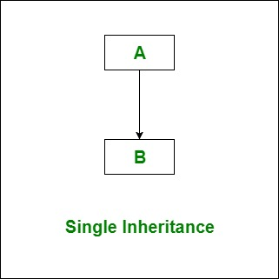
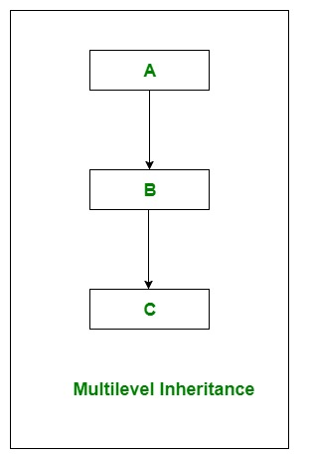
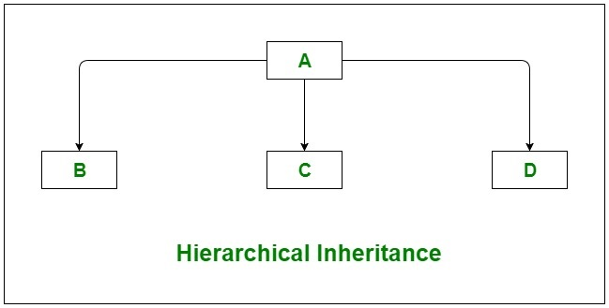
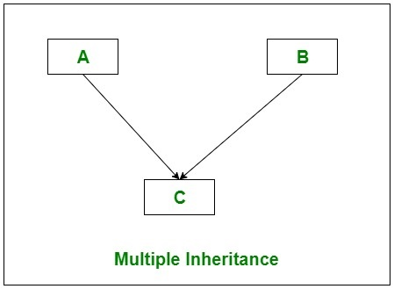
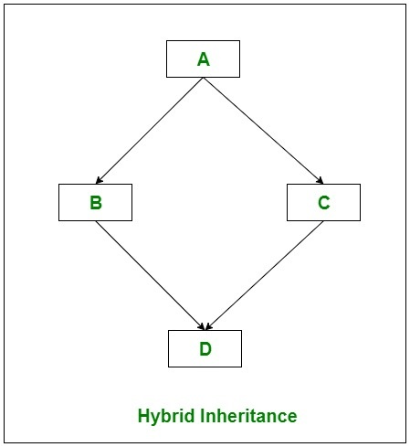
Types of Inheritance by images

Slide 8
Important facts about inheritance in C#
Default Superclass: Except Object class, which has no superclass, every class has one and only one direct superclass(single inheritance). In the absence of any other explicit superclass, every class is implicitly a subclass of Object class.
Superclass can only be one: A superclass can have any number of subclasses. But a subclass can have only one superclass. This is because C# does not support multiple inheritance with classes. Although with interfaces, multiple inheritance is supported by C#.
Inheriting Constructors: A subclass inherits all the members (fields, methods) from its superclass. Constructors are not members, so they are not inherited by subclasses, but the constructor of the superclass can be invoked from the subclass.

Slide 9
Private member inheritance: A subclass does not inherit the private members of its parent class. However, if the superclass has properties(get and set methods) for accessing its private fields, then a subclass can inherit.

Slide 10
Class derived class : base class
{
// methods and fields
}

Slide 11
C# Aggregation (HAS-A Relationship)
In C#, aggregation is a process in which one class defines another class as any entity reference. It is another way to reuse the class. It is a form of association that represents HAS-A relationship.

